Slide 1
COVID-19 Prevention Measures at School
Notes:
Today we will discuss COVID-19 Prevention Measures at School

Slide 2
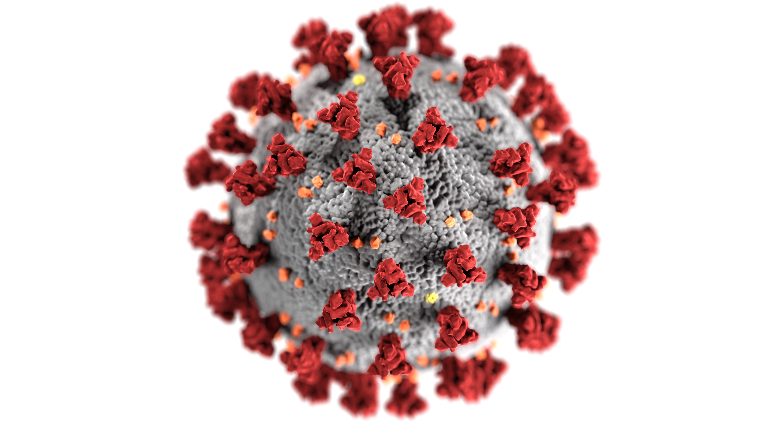
Topics Discussing Today
What is COVID-19 and Special Populations
Personal Preventive Measures:
  Face Masks
  Proper Hand Washing
  Social Distancing
Cleaning vs Disinfecting
COVID-19 Screening Process
Exposure Protocols
Notes:
At the completion of this presentation, you will be able to:
Identify the signs and symptoms of COVID-19
List the Special populations it affects
Know the proper use of Masks and how to properly clean and dispose of
Understand how to perform proper disinfecting of hands
Define Social distancing
Know the difference between clean and disinfect
Describe the screening process
Know what to do if you become ill, whether at school or at home.

Slide 3
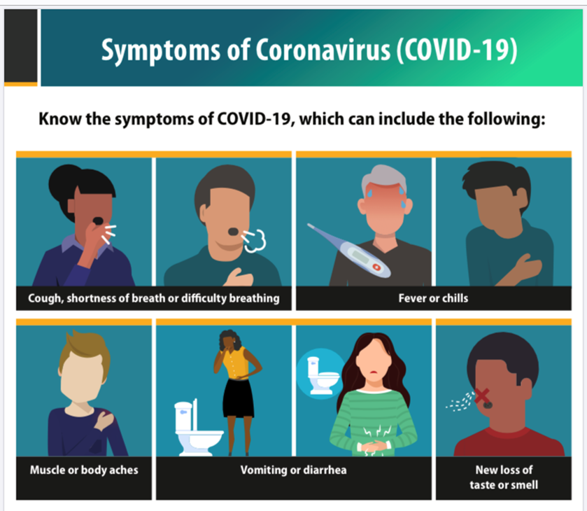
COVID-19
COVID-19 is a contagious respiratory illness caused by becoming infected with a new coronavirus, called SARS-CoV-2.
Because some of the symptoms of flu and COVID-19 are similar, it may be hard to tell the difference between them based on symptoms alone. A specific test is needed to confirm COVID-19 diagnosis.
Other COVID-19 symptoms, besides the ones on the picture in this slide, include headache and sore throat.

Slide 4
Symptoms of COVID-19
Symptoms of COVID-19 range from No symptoms (asymptomatic) to severe symptoms.
Symptoms can appear 2-14 days after being infected (exposure) with the virus, but it varies. Typically a person shows symptoms 5 days after exposure, but it can happen as early as 2 days and as late as 14 days after exposure.
A person with no symptoms can remain contagious for at least 10 days after testing positive for COVID-19.
It is possible to spread the virus up to 2 days before any symptoms appear and for at least 10 days after symptoms appear.

Slide 5

COVID-19
COVID-19 can spread:
  From person to person
  Between people who are in close contact. Close contact is within 6 feet for 15 minutes or more, even if face masks are worn by all people present.
COVID-19 is mainly spread by droplets made when people infected with the COVID-19 virus cough, sneeze, or talk.
These droplets can land in the mouths or noses of other people who are nearby and possibly be inhaled into the lungs. It may be possible that a person can get infected by physical human contact (example shaking hands) or by touching a surface/object that has the virus on it and then touching his or her own mouth, nose, and eyes.

Slide 6

Who is at Greater Risk to Get COVID-19?
Anyone Over the Age of 65
Having Underlying Conditions
Pregnant

Slide 7
Underlying Conditions and their Risk
High Risk, Regardless of Age | Moderate Risk, Regardless of Age
Cancer | Asthma (moderate to severe)
Chronic Kidney Disease | Cerebrovascular Disease (affects blood vessels and supply of blood to the brain)
COPD (Chronic Obstructive Pulmonary Disease | Cystic Fibrosis
Immunocompromised (weakened immune system) | Hypertension (high blood pressure)
Obesity: Body Mass Index (BMI) of 30 or higher | Liver Disease
Serious heart conditions, such as heart failure, coronary heart disease, cardiomyopathy | Neurological Conditions such as Dementia
Sickle Cell Disease | Pulmonary Fibrosis (having damaged or scarred lung tissue)
Diabetes Mellitus | Smoking
 | Thalassemia (a type of blood disorder)

Slide 8
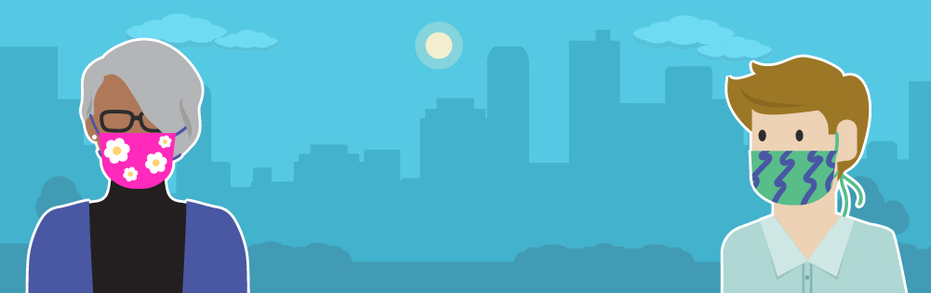
Use Masks to Help Slow the Spread of COVID-19
Everyone must wear a mask, except: anyone younger than 2 years old, anyone who has trouble breathing or is unconscious, anyone who is incapacitated or otherwise unable to remove the mask without assistance.
Your mask protect them.
Their mask protect you.

Slide 9
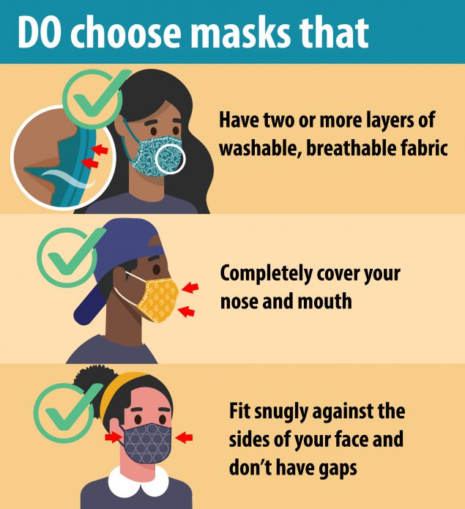
Masks
Masks must have at least two layers of washable, breathable fabric.
Wear a mask that completely covers your nose and mouth to help protect others in case you’re infected with COVID-19 but don’t have symptoms.
The mask must be secured under your chin and fit snugly against the sides of your face.
Wear a mask in public settings when around people who don’t live in your household. Remember the school is a public setting.

Slide 10
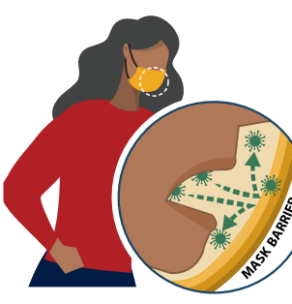
Wear a Mask Correctly and Consistently for the Best Protection
Be sure to wash your hands before putting on a mask, before and after taking off your mask.
Do NOT touch the mask when wearing it, especially the front of the mask. If you find yourself doing so, it means that your mask does not fit snugly against your face.
Masks are always to be worn while on campus for example, lounge, copy room, halls, stairwells, elevator, foyer, restrooms, etc.
Medical documentation is required if you are not able to wear a mask.

Slide 11
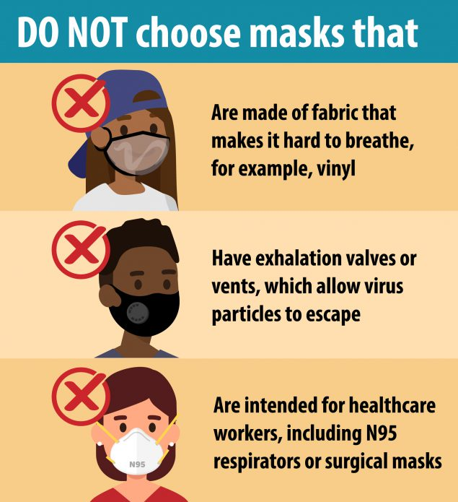
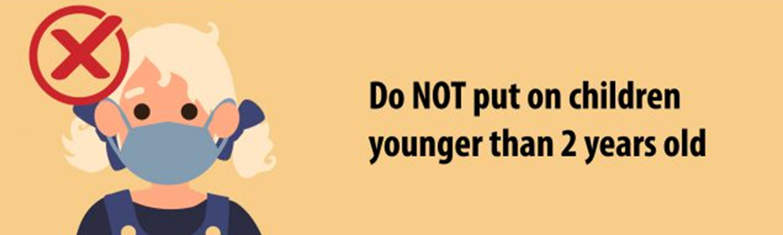
When working with special populations, you may wear a face mask that makes lips/mouth visible. Change back to an approved mask as soon as you are done.
Masks should NOT be worn by children younger than two, people who have trouble breathing, or people who cannot remove the mask without assistance. This means that some students with special needs, regardless of age, may not wear masks.

Slide 12
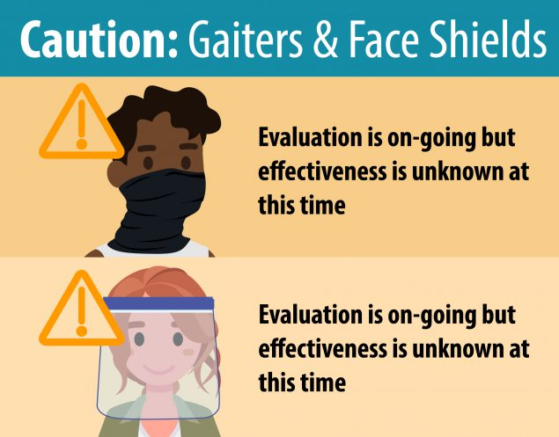
Gaiters are thin and their effectiveness is still unknown. Wear a mask made of at least two layers of breathable fabric.
A face shield is primarily used for eye protection for the person wearing it. At this time, there is not enough evidence to support the effectiveness of face shields for source control. Therefore, CDC does not currently recommend use of face shields as substitutes for masks.
You can wear a face shield but you must also wear a face mask.
When wearing a face shield, ensure the face shield covers all the way down past your chin.

Slide 13
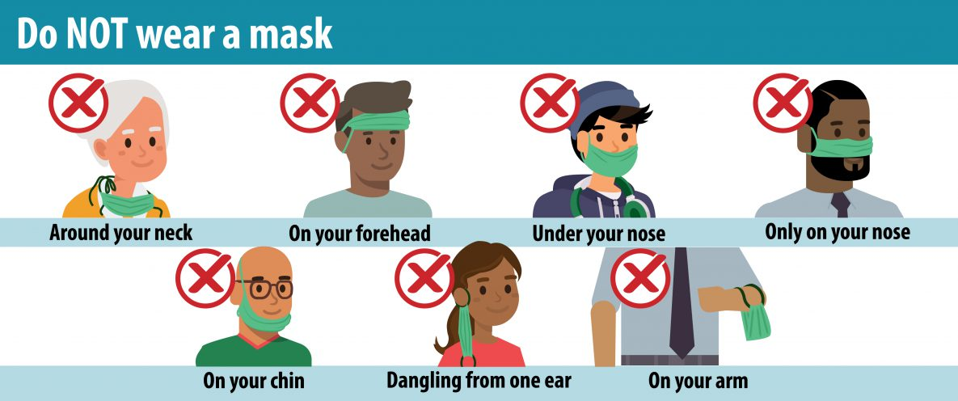
Don’t put your mask under your nose. Your mask must always cover your nose and your mouth.
Don’t put the mask around your neck or on your forehead.
Don’t touch the front or sides of your mask, and if you do, wash your hands or use hand sanitizer to disinfect your hands.

Slide 14
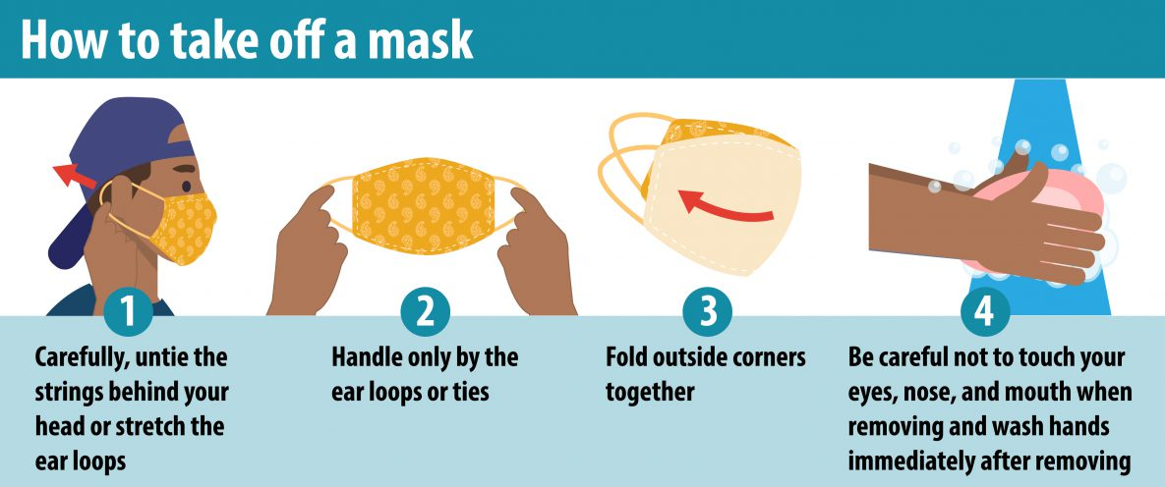
Wash your hands before and after removing your mask.
You can place your mask inside a zip lock bag to prevent it from touching commonly touched surfaces and contaminate your mask.

Slide 15
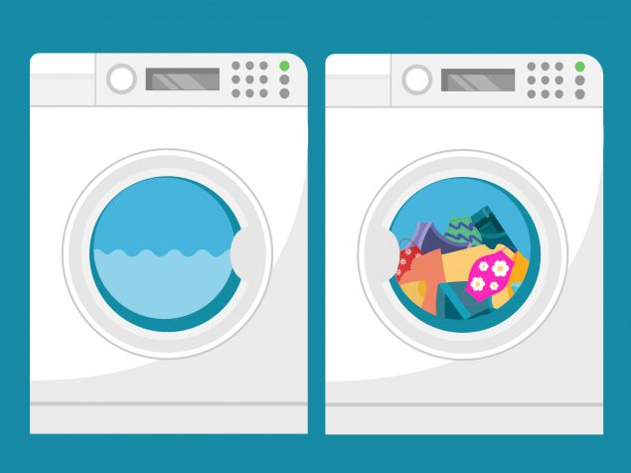
How to Clean Reusable Face Masks
Masks should be washed regularly. Always remove masks correctly and wash your hands after handling or touching a used mask.
Include your mask with your regular laundry.
Use regular laundry detergent and the warmest appropriate water setting for the cloth used to make the mask.
Use the highest heat setting and leave in the dryer until completely dry.
The washing machine is the most practical way to clean your reusable masks. Hand washing requires more steps and disinfecting solutions in order to clean it properly.
Surgical mask are not washable. Dispose of surgical mask inside a plastic bag before throwing away.

Slide 16
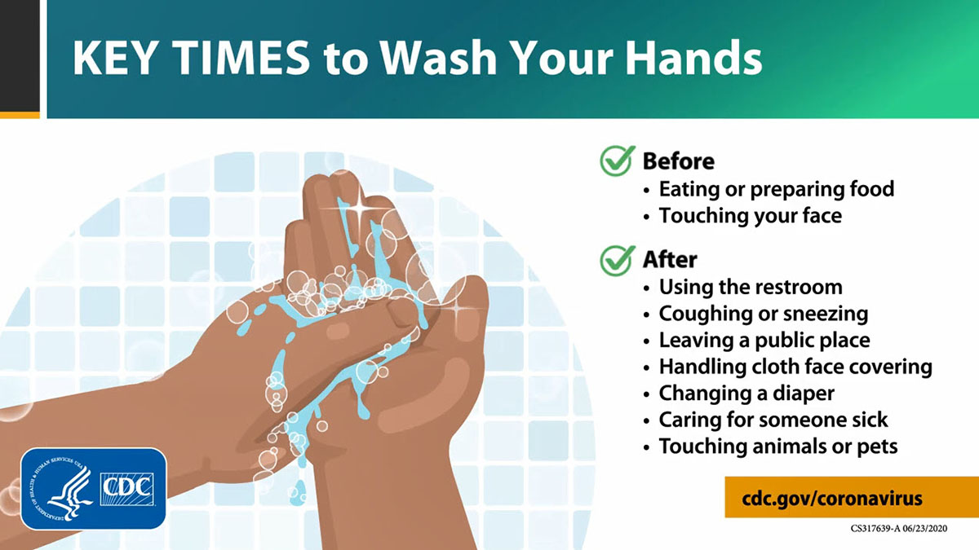
Handwashing
Notes:
Don’t touch your eyes, nose and mouth with your hands.

Slide 17
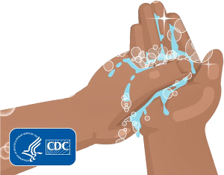
Handwashing
Handwashing is the upmost important way to keep healthy.
Wash your hands with soap and water for at least 20 seconds, scrubbing every part of your hands and wrists.
By rubbing the soap over your hands and wrists, you allow the soap to grab germs and viruses that get washed off with the water, leaving your hands clean.
Do not put your hands under the running water while rubbing the soap on your hands, as the soap will not do its work and your hands will not be clean.
If soap and water is not easily available, you can use hand sanitizer that is made of at least 60% alcohol. Apply the hand sanitizer all over the hands and wrists areas and allow it to dry.
Discourage the use of bathroom hand dryers. Use paper towels instead.
Cover your cough or sneeze with a tissue, throw away the tissue in the trash, and wash your hands.

Slide 18
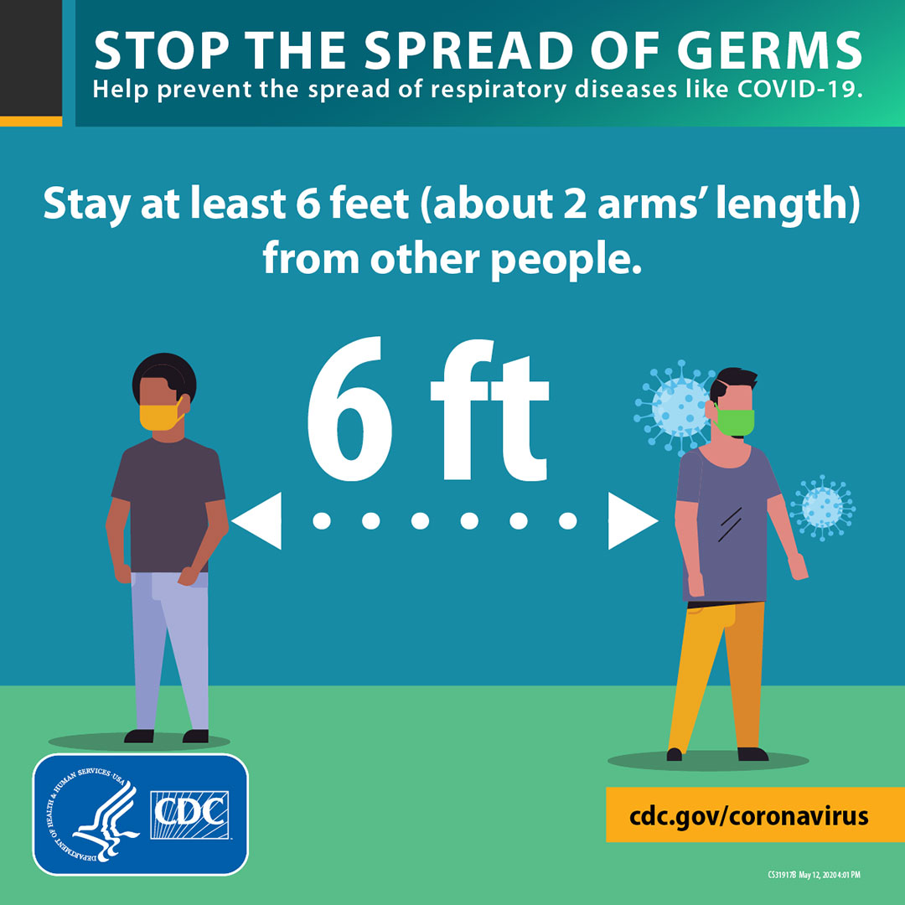
Social Distancing and Close Contact
Practice social distancing by putting space between yourself and others. Six feet apart is about the same as two arms lengths from other people.
Close contact is being 6 feet apart or closer with another person for at least 15 minutes, even if everyone is wearing a mask. It also applies if the other person is NOT wearing a mask.
In areas such as the copy room, ensure social distancing is maintained. Do not congregate in the copy room or lunchroom if proper social distancing cannot always be maintained.

Slide 19

Social Distancing
In the school setting, to keep social
distancing, use directional signage,
for example:
Stay on the right of the hallway to keep from coming face to face with another person.
If the hallway is narrow and the 6 feet apart distance cannot be kept, designate and map a “One Way” direction for everyone one to follow. Make sure the “One Way” gets communicated to the entire staff.

Slide 20
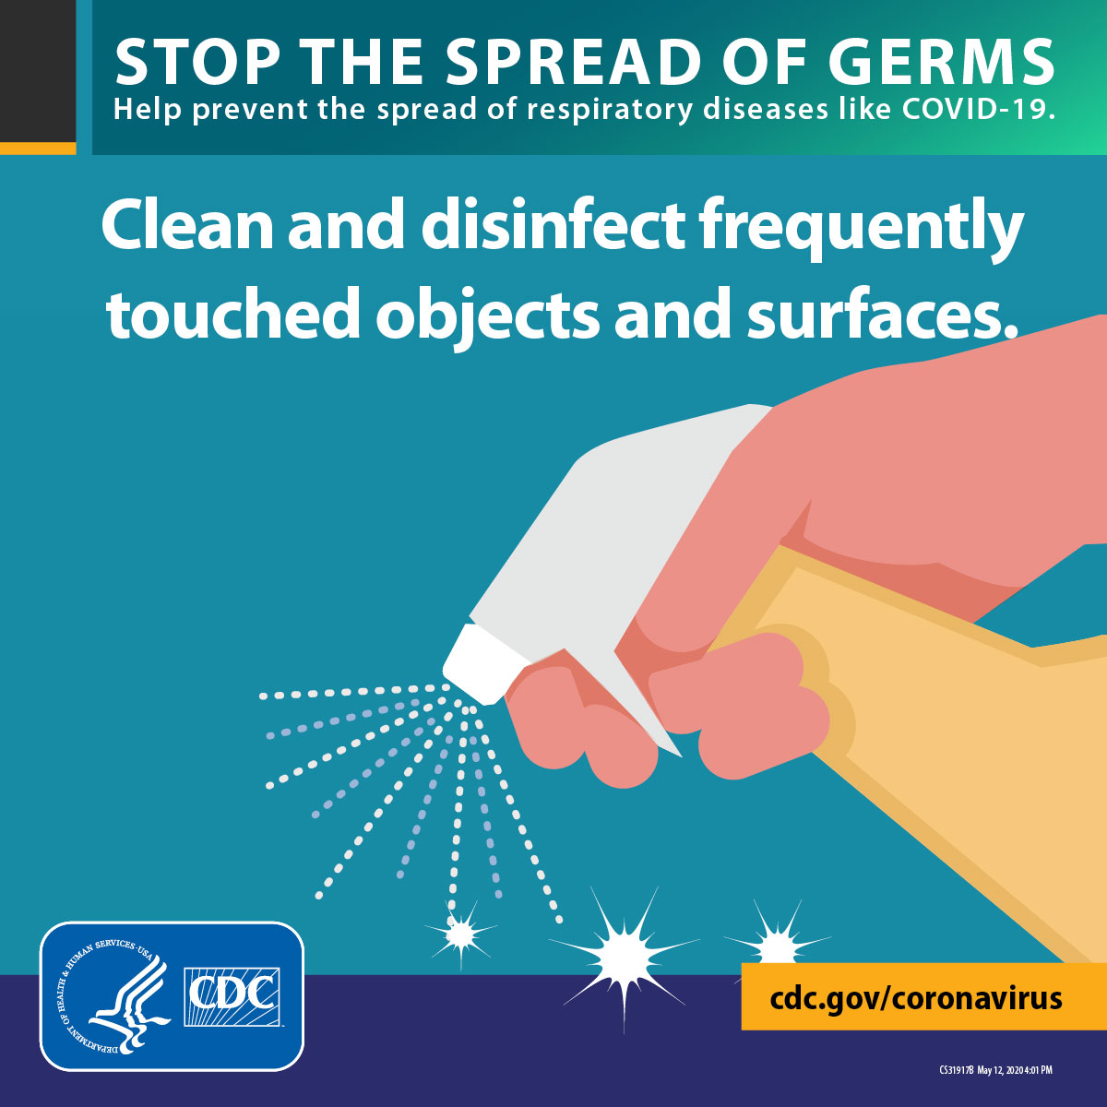
Cleaning vs Disinfecting
Cleaning with soap and water reduces number of germs, dirt and impurities on the surface.
Disinfecting kills germs on surfaces. Certain chemicals are needed to disinfect.
Clean surfaces using soap and water, then use disinfectant. Make sure that you wear reusable or disposable gloves for routine cleaning and disinfection.
Practice routine cleaning (hourly) of frequently touched surfaces. High touch surfaces include but not limited to:
  Tables, Doorknobs, light switches,
  Countertops, handles, desks,
  Phones, keyboards, tablets
  Toilets, faucets, sinks

Slide 21
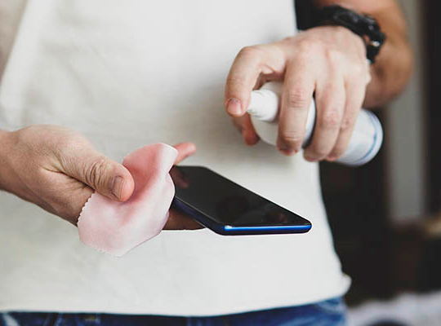
Cleaning and Disinfecting
Whenever possible, leave the doors propped open to minimize touching.
Do not share headsets or other objects that are near your mouth or your nose, for example phones or microphones.
Electronic equipment can be cleaned following the manufacturer’s instructions.

Slide 22

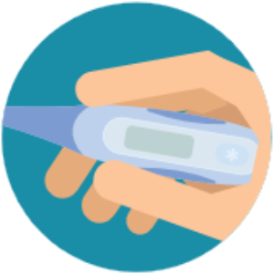
Self Screening
Everyone needs to self screen for COVID-19 symptoms at home daily.
Do not come to work if you are feeling ill.
To facilitate onsite screening, there must be designated entry points into the school/building for everyone to use.
Campus principal assigns staff to Wellness Team to perform screenings.
The Plant Operator will be responsible to screen his/her staff and keep documentation of the screenings.
The Cafeteria Manager will be responsible to screen his/her staff and keep documentation of the screenings.

Slide 23
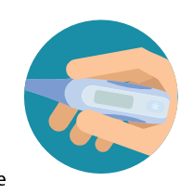

Self Screening
Daily screenings of COVID-19 symptoms for everyone whether at home or coming into an HISD building is mandatory. An app for daily screenings will be forthcoming.
In the meantime, everyone who enters the building will get a COVID-19 symptom screening and a temperature will be taken as part of the screening:
  HISD Employees
  Students and Parents
  Visitors
Entrance to the building will be denied to any person who:
  reports having any symptom of COVID-19 and/or
  Has a temperature equal to or greater than 100 degrees and/or
  Refuses to wear a face mask
After the initial daily screening, an employee can come in and out of the school campus as needed for that specific day.
A screening log will be kept for documentation purposes and to assist with contact tracing in the event of a possible COVID-19 case.

Slide 24
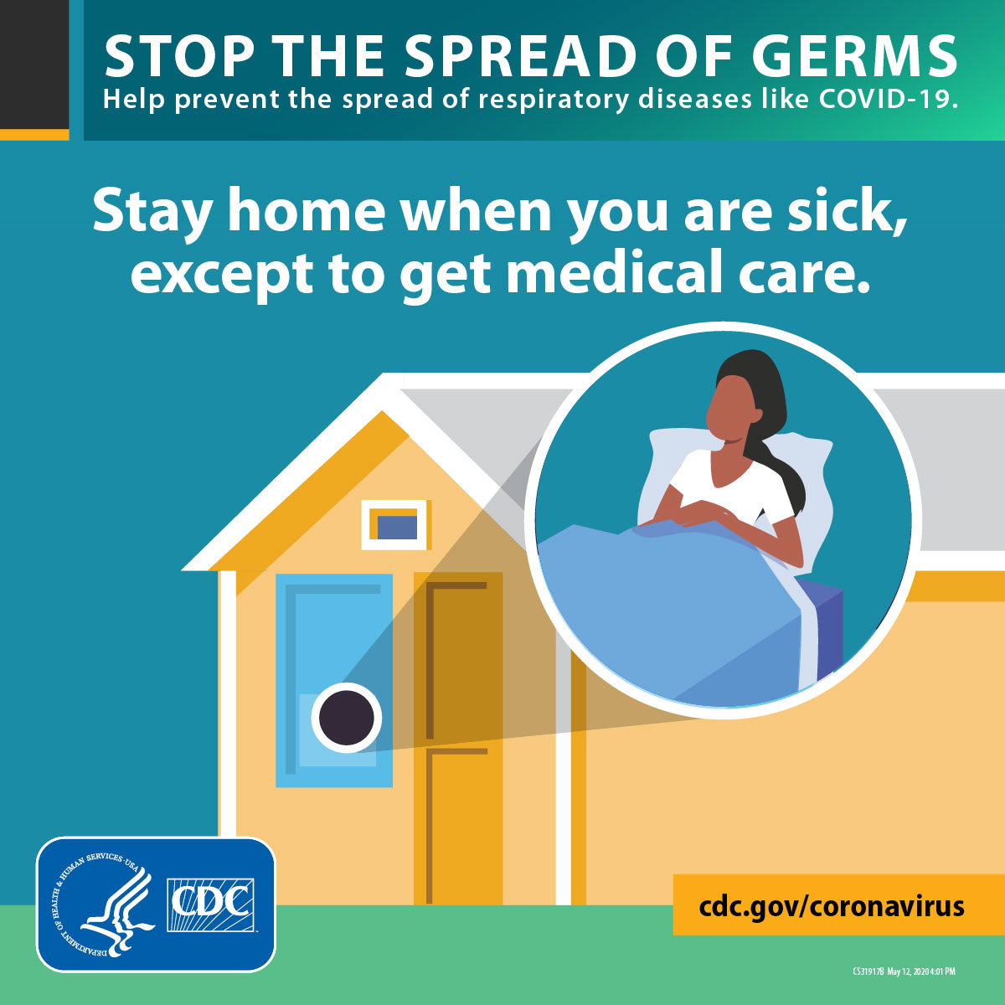
Procedures if You Are ill at Home
Stay home if you are sick, except to get medical care. If you need medical attention, call your medical provider and follow his/her instructions.
Notify your supervisor and your school nurse of your absence.
Separate yourself from other people and pets in your home.
As much as possible, stay in a specific room and away from other people and pets in your home.
If possible, you should use a separate bathroom.
If you need to be around other people or animals in or outside of the home, wear a mask.
Notes:
Avoid public transportation, ride-sharing, or taxis while you are ill.

Slide 25
Procedures if you Become ill at School
If you become ill while at school, stay in your area and notify the school nurse immediately.
Do not walk around the school or be in contact with other employees.
The school nurse will notify you of next steps to take.
Every school is required to have an isolation room for staff and students who become ill at school and exhibit signs and symptoms of COVID-19.

Slide 26
Quarantine vs Isolation
Isolation or Quarantine: What's the difference?
  Quarantine keeps someone who might have been exposed to the virus away from others.
  Isolation keeps someone who is infected with the virus away from others, even in their home.
If you were in close contact with someone who became COVID-19 positive within the past 14 days, you need to self quarantine. Notify your supervisor and school nurse.
If you develop COVID-19 symptoms while in quarantine, notify your medical provider and your school nurse.
If you test positive for COVID-19, you need to isolate yourself and notify your supervisor and your school nurse.
Notes:
If you are in quarantine, and you are well and able to continue to work, you may do so from home.

Slide 27
When to come back from Quarantine or Isolation
If you tested positive for COVID-19 (confirmed COVID-19 case), you can be with others after:
At least 14 days have passed since symptoms first appeared and
At least 24 hours have passed with no fever without fever-reducing medication and
Other symptoms of COVID-19 are improving**Loss of taste and smell may persist for weeks or months after recovery and need not delay the end of isolation​
If you were in quarantine due to being in close contact with a positive COVID-19 case, you can be with others:
14 days have passed after the last contact with the individual that tested positive for COVID-19.
Contact the school nurse prior to your return to the building.
These guidelines may change, and you will be notified of any changes.

Slide 28
References
https://www.cdc.gov/coronavirus/2019-ncov/need-extra-precautions/people-with-medical-conditions.html?CDC_AA_refVal=https%3A%2F%2Fwww.cdc.gov%2Fcoronavirus%2F2019-ncov%2Fneed-extra-precautions%2Fgroups-at-higher-risk.html
https://www.fda.gov/medical-devices/personal-protective-equipment-infection-control/n95-respirators-surgical-masks-and-face-masks N95 Respirators, Surgical Masks and Face Masks. Accessed 09/18/2020.
https://www.cdc.gov/coronavirus/2019-ncov/prevent-getting-sick/about-face-coverings.html. Accessed 09/09/2020. CDC How to Select, Wear and Clean your Mask; updated 08/27/2020.
https://www.cdc.gov/coronavirus/2019-ncov/communication/social-media-toolkit.html. Accessed 09/10/2010. Coronavirus Disease 2019 (COVID-19) Social Media Toolkit; updated 09/08/2020.
https://www.cdc.gov/coronavirus/2019-ncov/if-you-are-sick/steps-when-sick.html. Accessed 09/10/2010. Coronavirus Disease 2019 (COVID-19) What to do if you are sick; updated 05/08/2020.
https://www.cdc.gov/coronavirus/2019-ncov/if-you-are-sick/end-home-isolation.html Accessed 9/16/2020. Coronavirus Disease 2019 (COVID-19) Isolate if you are sick; updated 09/10/2020
https://tea.texas.gov/sites/default/files/covid/SY-20-21-Public-Health-Guidance.pdf Accessed 09/16/2020. SY 20-21 Public Health Planning Guidance; updated 09/02/2020.

